Slide 1
Client-server application «VTravel»
Course project

Slide 2
Objective
Application development
based on .Net Framework,
allowing for virtual travel
through an interactive map of the World

Slide 3
Application functions
Moving around the world map
Search and view geographic and natural attractions
Street views
Collection of favorites
User chat

Slide 4
Overview of Similar Existing Applications
GoogleErth
https://www.google.com.ua/intl/uk/earth/
Pinterest
https://www.pinterest.com.mx/pin/545850417315517387/

Slide 5
Applied software
Wpf
Entity
BingMaps Api
https://docs.microsoft.com/en-us/bingmaps/#pivot=main&panel=BingMapsAPI
Bing Maps WPF Control
https://docs.microsoft.com/en-us/previous-versions/bing/wpf-control/hh830433(v=msdn.10)

Slide 6
Applied software …
Google Maps Platform
https://cloud.google.com/maps-platform/?hl=ru
Places Api
https://developers.google.com/places/web-service/overview?hl=ru
Place Search service
https://developers.google.com/places/web-service/search?hl=ru
Place Details service
https://developers.google.com/places/web-service/details?hl=ru
Place Photos service
https://developers.google.com/places/web-service/photos?hl=ru
Street View Static API
https://developers.google.com/maps/documentation/streetview/overview?hl=ru

Slide 7
Applied software …
WikiData Api
https://www.wikidata.org/wiki/Wikidata:Data_access
SPARQL Editor
https://query.wikidata.org/
SPARQL tutorial
https://www.wikidata.org/wiki/Wikidata:SPARQL_tutorial#Qualifiers
SPARQL examples
https://www.wikidata.org/wiki/Wikidata:SPARQL_query_service/queries/examples

Slide 8
Applied software …
Rest Countries Api
https://restcountries.eu/
Svg.dll
Newtonsoft.Json.dll

Slide 9
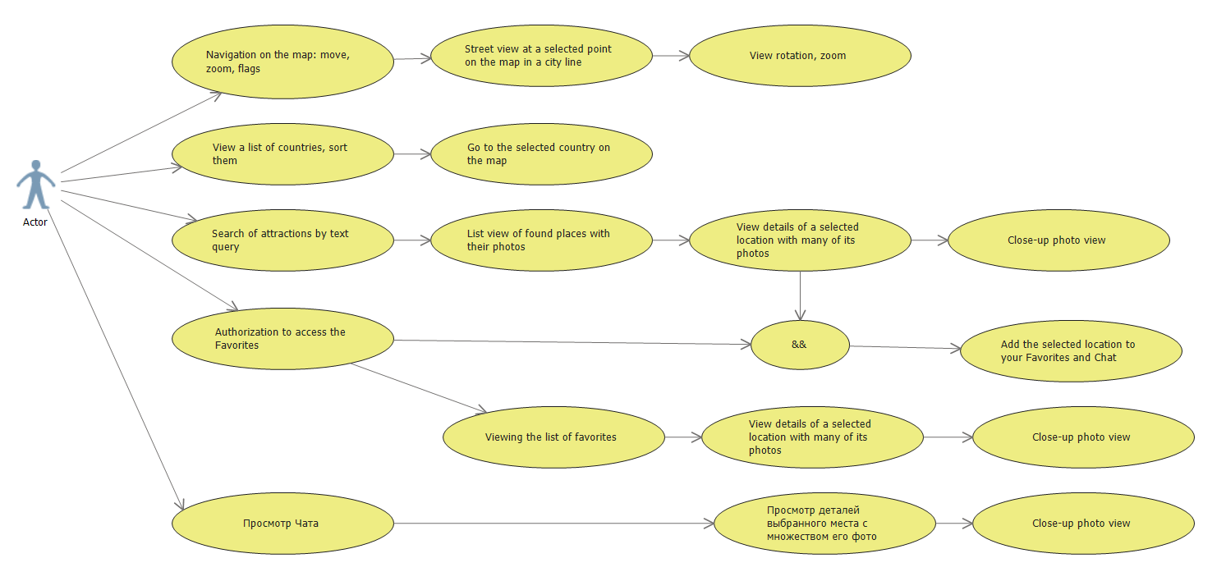
Use case diagram

Slide 10
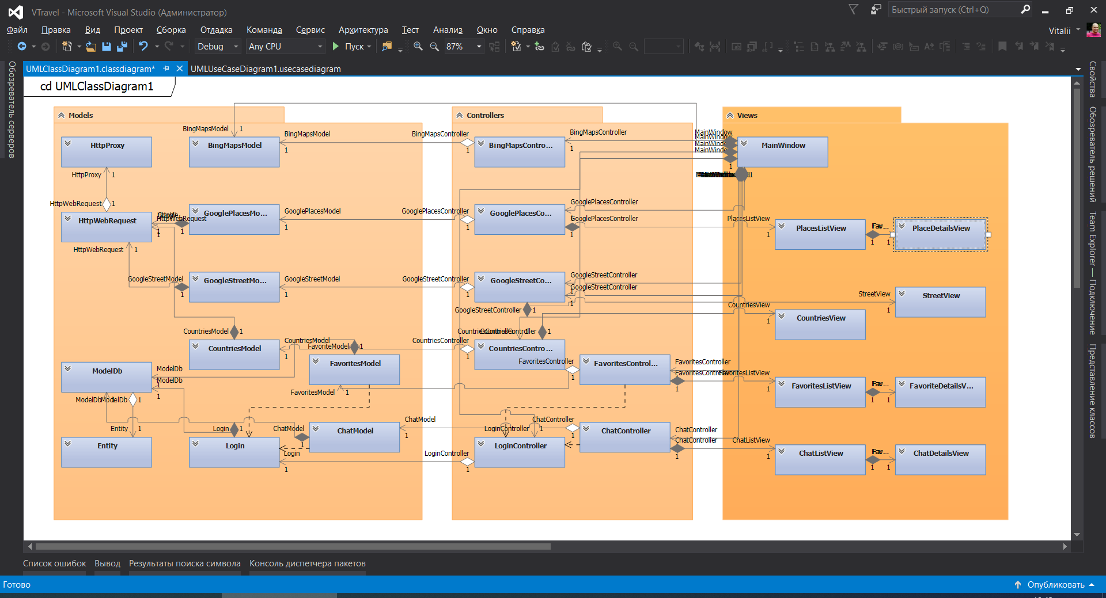
MVC – class diagram

Slide 11
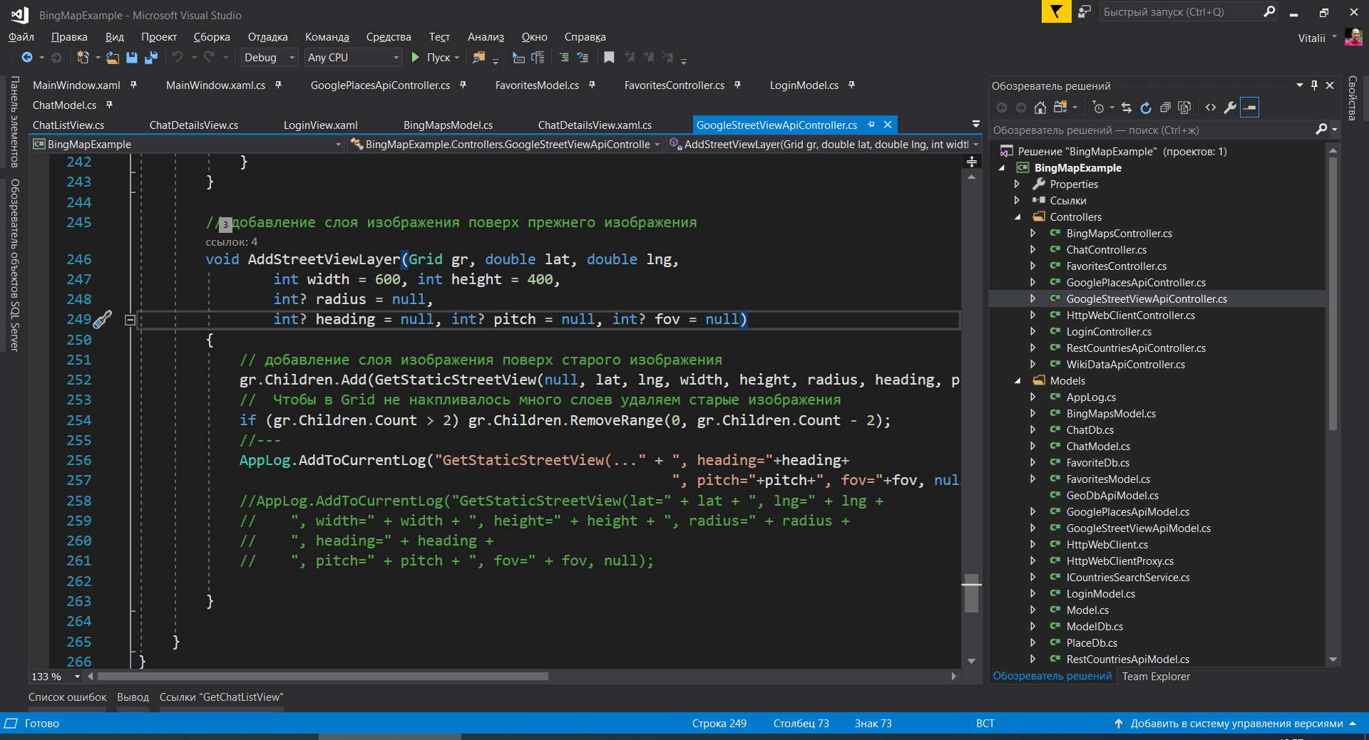
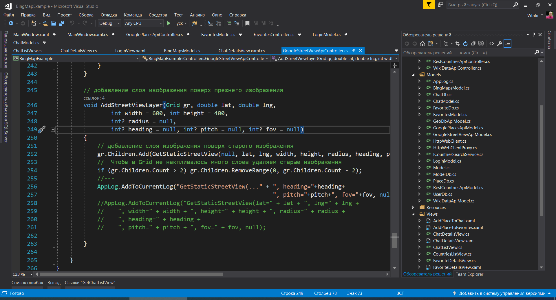
MVC-file structure

Slide 12
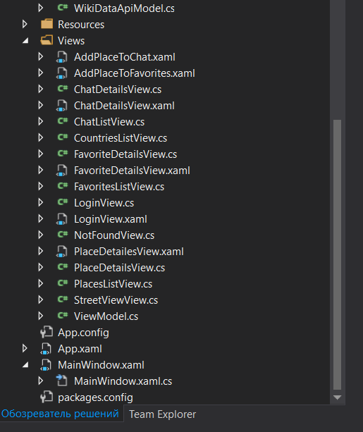
continue …

Slide 13
Application implementation …

Slide 14
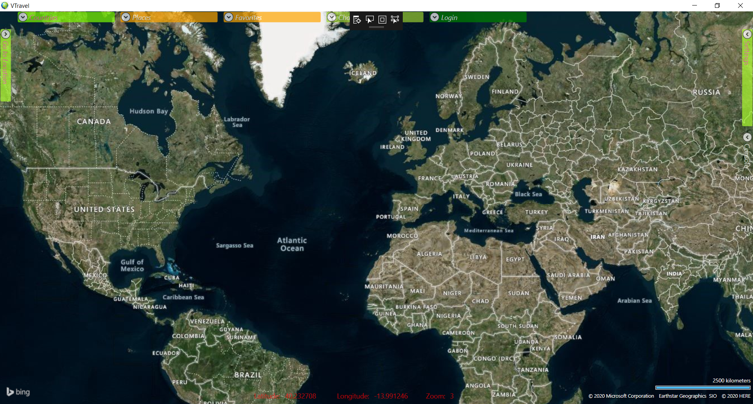
Moving around the world map Bing Maps WPF Control

Slide 15
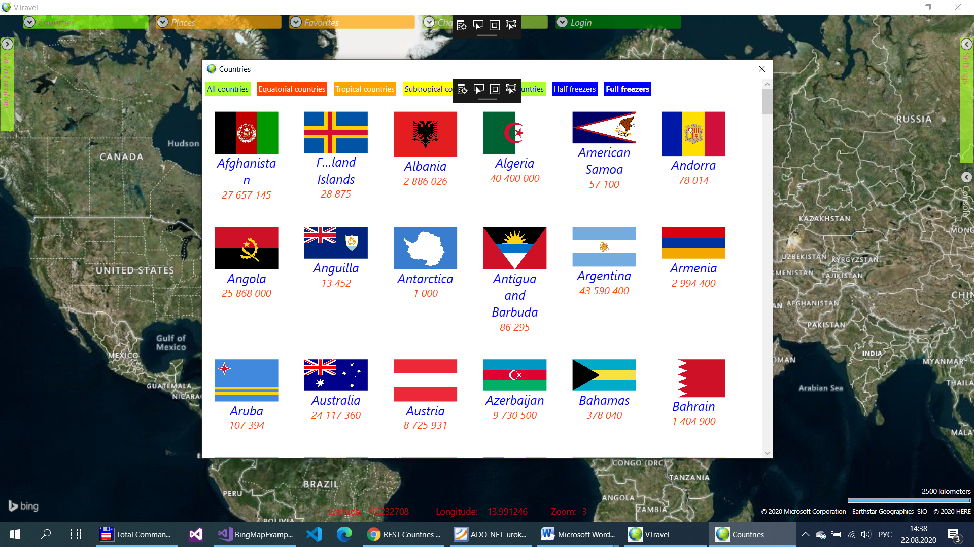
Search countries Rest Countries Api

Slide 16
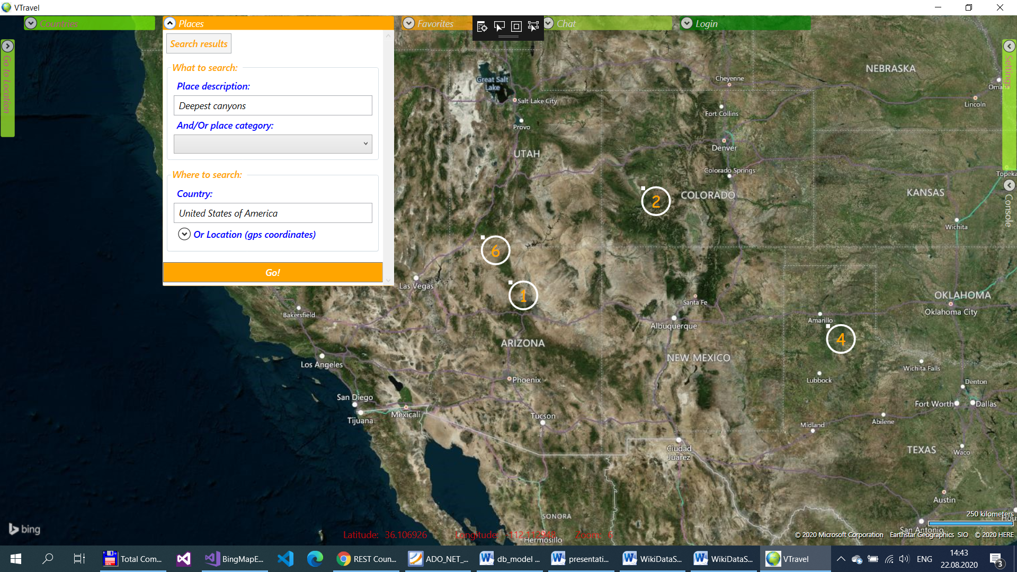
Search for attractions Google Place Search service

Slide 17
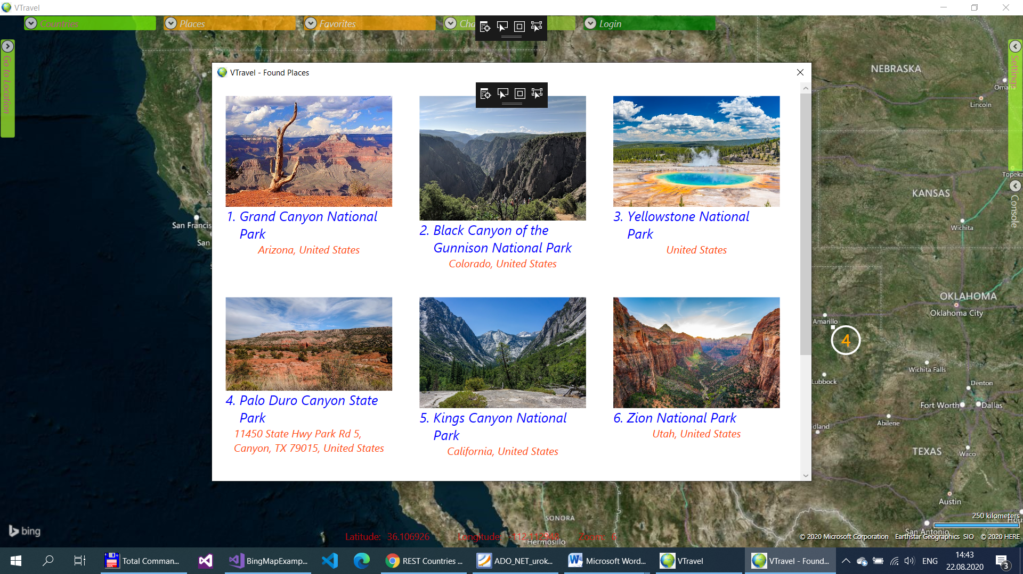
List of found attractions Google Place Search service

Slide 18
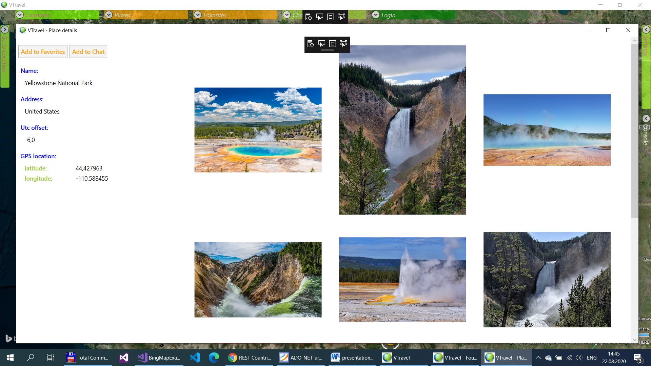
Detailed view of the selected attraction Google Place Details service

Slide 19
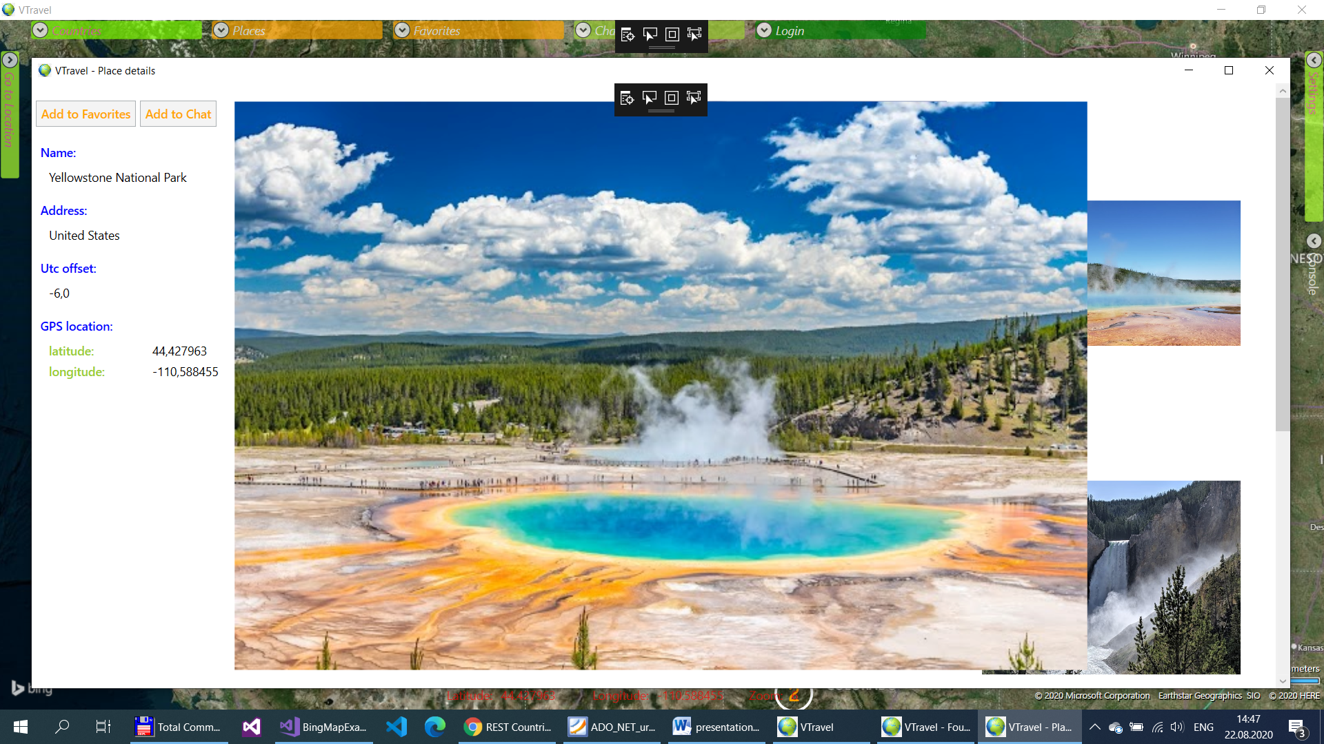
Close-up photo with zoom Google Place Photos service

Slide 20
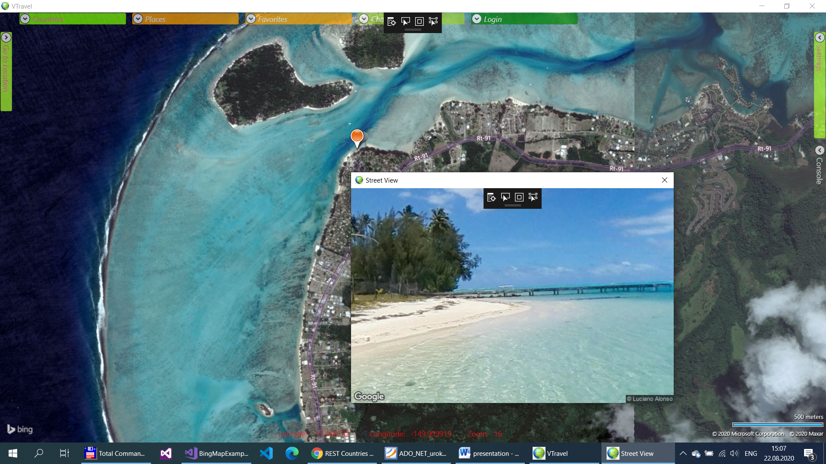
Street views with zoom and rotation Google Street View Static API

Slide 21
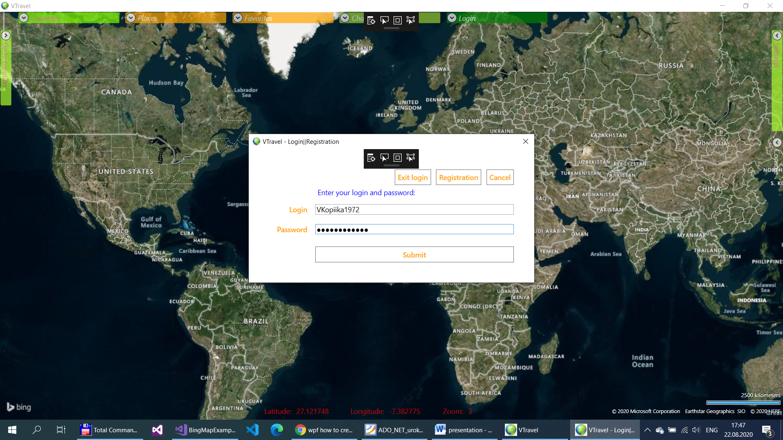
Authorization to access favorites and chat

Slide 22
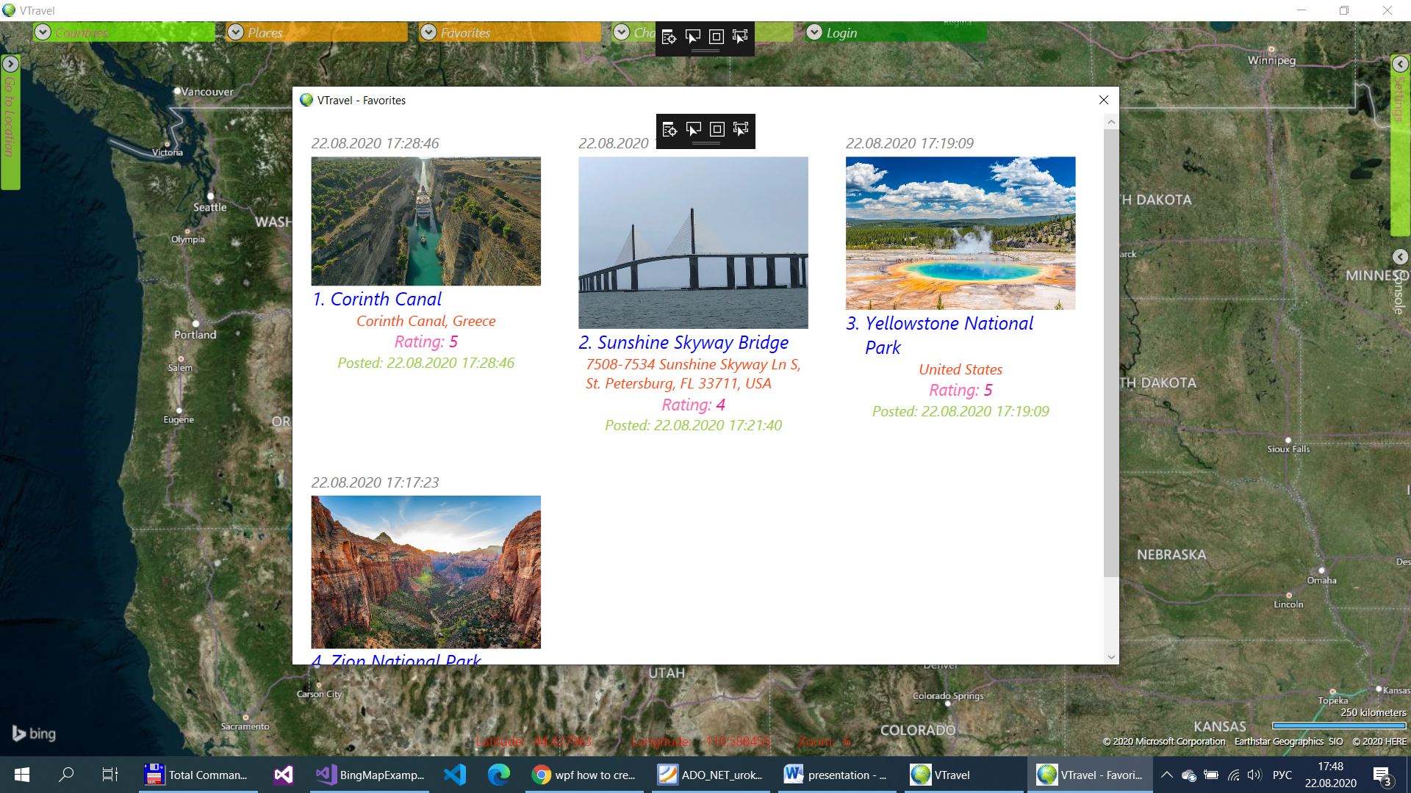
Favorites

Slide 23
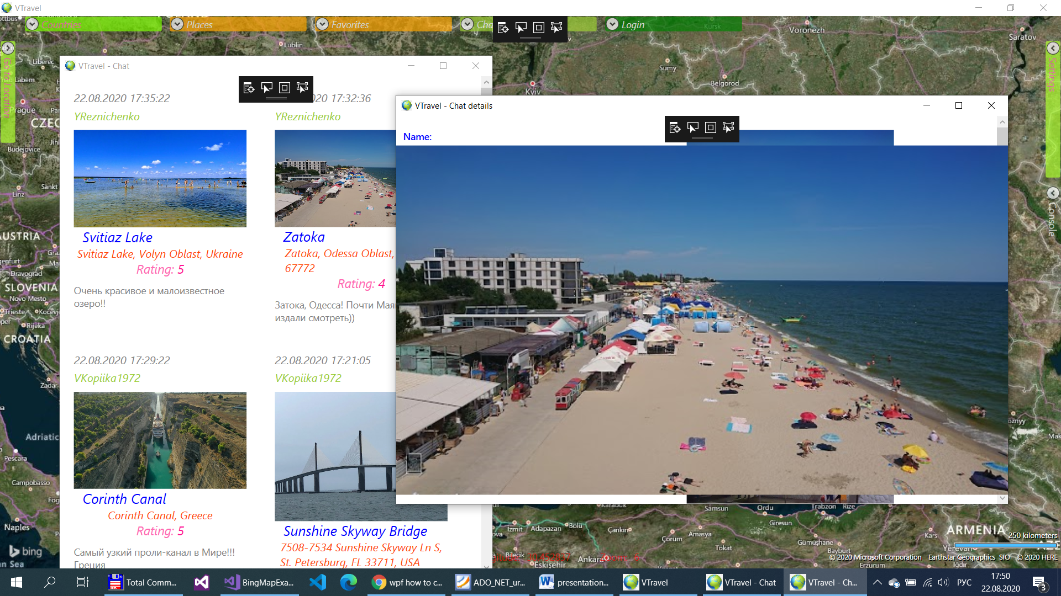
Chat

Slide 24
Outcomes:
A large amount of new material has been studied:
Google Place Search Api
Bing Maps Api
WikiData Api
The application implements:
easy navigation on the map and viewing
convenient street views
search and viewing of attractions
The application will be useful in a number of applications:
entertainments
education
Practical using

Slide 25
Thanks for your attention!

